Slide 1
Introduction to Machine Learning Fundamentals Data exploration
Vera Hollink
2025

Slide 2

Machine Learning
Computers learn from examples to perform complex tasks

Slide 3
Course overview
Week | Topics
1 | Machine Learning fundamentals, Exploration, Preprocessing
2 | Regression
3 | Regression, Principal Component Analysis
4 | Classification
5 | Evaluation
6 | Clustering
7 | Assignment, Exam preparation

Slide 4
Literature and materials
Liu, Y. (2020) Python Machine Learning By Example - Third Edition. ‎ Packt Publishing. ISBN-13: 978-1800209718.
Slides
Moodle: course guide, exercises, assignment, slides, data sets

Slide 5

Format
Self study
Book
Classes
Lectures
Exercises
Assessment
30% python assignment
70% exam

Slide 6
Today
Machine Learning fundamentals
Chapters 1.1-1.3
Data exploration
Chapter 1.5

Slide 7
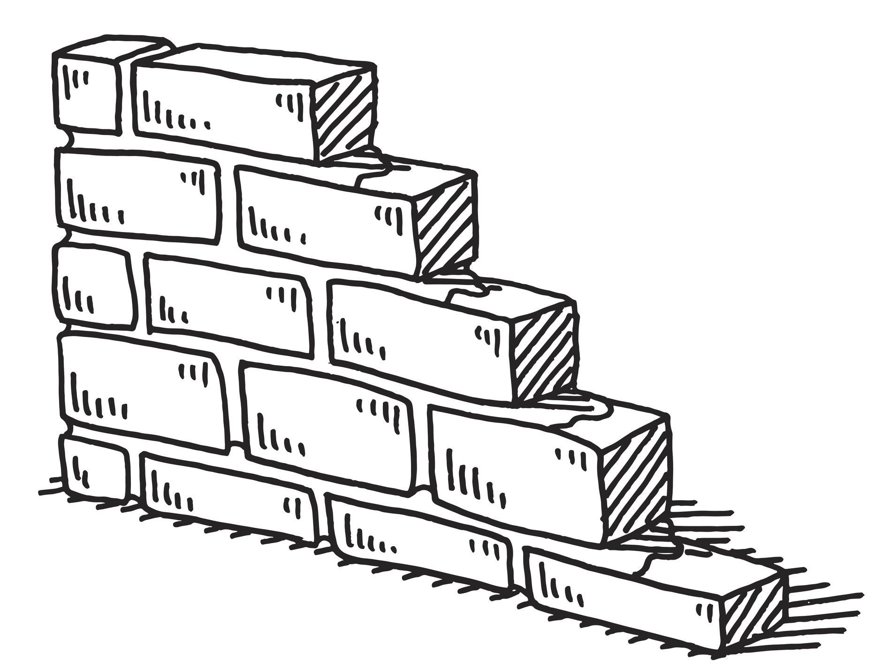
Machine Learning Fundamentals

Slide 8
Artificial Intelligence (AI)
Machines perform complex tasks
Examples?
Can Machines outperform humans?
More computational power (Go)
Never distracted (self-driving cars)
More precise (robotic arm)
Learn from more examples (cancer diagnosis)

Slide 9
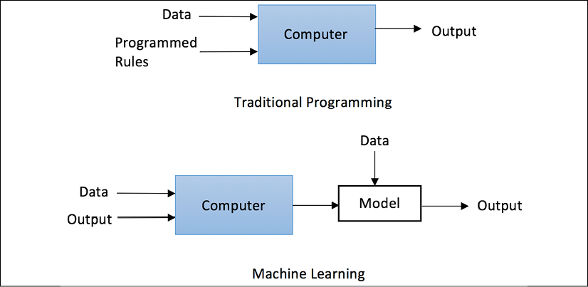
Machine Learning ⸦ AI

Slide 10
Basic machine learning tasks
Classification: predict class
Prediction/ predict numerical value regression:
Time-series: predict trend Analysis
Association: X% with this also have that
Clustering: group cases

Slide 11
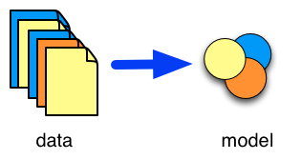
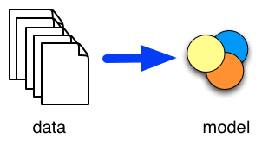
Types of tasks
Supervised learning
Unsupervised learning
Classification
Prediction/regression
Time-series (forecasting)
Clustering
Associations
Time-series (modelling)

Slide 12
More types of machine learning
Semi-supervised learning
Reinforcement learning
Deep Learning
AI ⸧ Machine Learning ⸧ Deep Learning

Slide 13
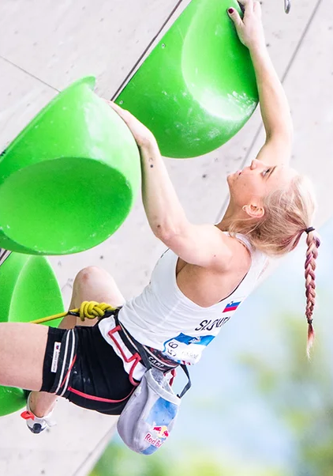
Terminology: sample, attributes, values
Sample:
First name: Janja
Lastname: Garnbret
Country: Slovenia
Gender: woman
Age: 22
Competition:
Olympics 2021
Gold
Mina
Notes:
Mina Markovic: beste klimster van de wereld: on sight 8b+

Slide 14
Terminology
Data set
Data table
Flat file
Person ID | Age | Gender | Income | Balance | Mortgage payment
123213 | 32 | F | 25000 | 32000 | Y
17824 | 49 | M | 12000 | -3000 | N
232897 | 60 | F | 8000 | 1000 | Y
288822 | 28 | M | 9000 | 3000 | Y
…. | …. | …. | …. | …. | ….

Slide 15
Terminology
Samples
Records
Instances Cases
Person ID | Age | Gender | Income | Balance | Mortgage payment
123213 | 32 | F | 25000 | 32000 | Y
17824 | 49 | M | 12000 | -3000 | N
232897 | 60 | F | 8000 | 1000 | Y
288822 | 28 | M | 9000 | 3000 | Y
…. | …. | …. | …. | …. | ….

Slide 16
Terminology
Variables
Attributes
Features
Columns
Person ID | Age | Gender | Income | Balance | Mortgage payment
123213 | 32 | F | 25000 | 32000 | Y
17824 | 49 | M | 12000 | -3000 | N
232897 | 60 | F | 8000 | 1000 | Y
288822 | 28 | M | 9000 | 3000 | Y
…. | …. | …. | …. | …. | ….

Slide 17
Terminology
Predictors
Explanatory variables/attributes
Independent variables
Person ID | Age | Gender | Income | Balance | Mortgage payment
123213 | 32 | F | 25000 | 32000 | Y
17824 | 49 | M | 12000 | -3000 | N
232897 | 60 | F | 8000 | 1000 | Y
288822 | 28 | M | 9000 | 3000 | Y
…. | …. | …. | …. | …. | ….

Slide 18
Terminology
Target variable/attribute
Class
Dependent variable
Person ID | Age | Gender | Income | Balance | Mortgage payment
123213 | 32 | F | 25000 | 32000 | Y
17824 | 49 | M | 12000 | -3000 | N
232897 | 60 | F | 8000 | 1000 | Y
288822 | 28 | M | 9000 | 3000 | Y
…. | …. | …. | …. | …. | ….

Slide 19
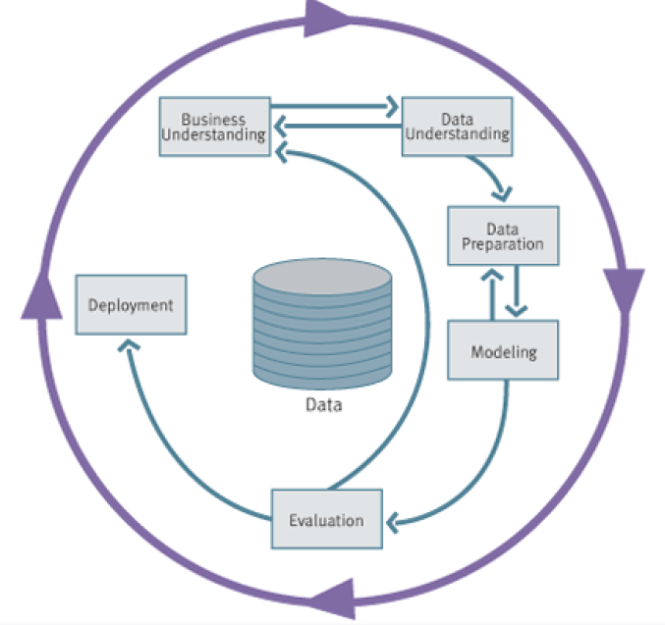
Data Mining Process: CRISP-DM
Image from “Data Science for Business”, Provost and Fawcett, 2013
Notes:
* Cross-Industry Standard Process for Data Mining (Shearer, 2000)

Slide 20

Data exploration

Slide 21
Data Mining Process: CRISP-DM
Image from “Data Science for Business”, Provost and Fawcett, 2013
Notes:
* Cross-Industry Standard Process for Data Mining (Shearer, 2000)

Slide 22
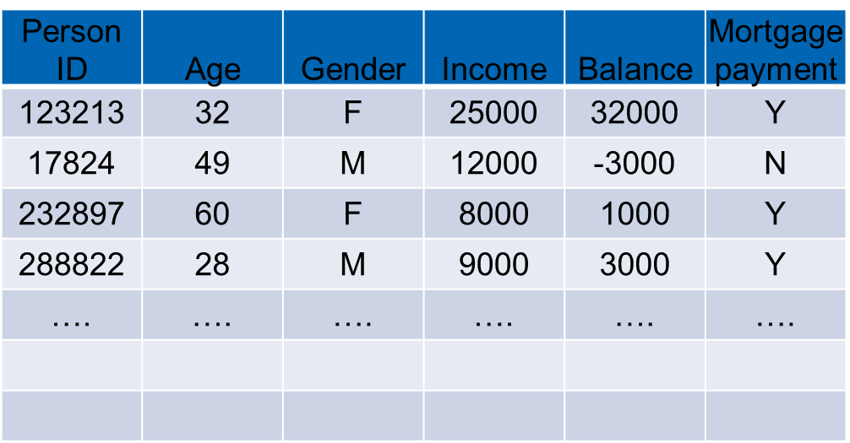
Data set
Source, trustworthiness
Type of data set
Structured (database table)
Text
Transactions
Graph/network data
Spatial data
Multimedia

Slide 23
Data set
Which instances (selection)
How many instances
How many attributes
Meaning attributes
Redundant attributes
Overlap other data sets
Attributes
Instances (range)
Scale

Slide 24
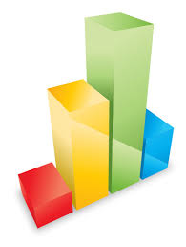

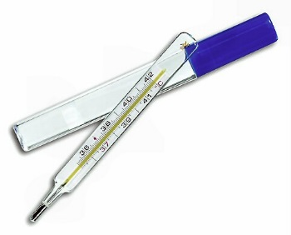
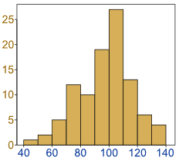
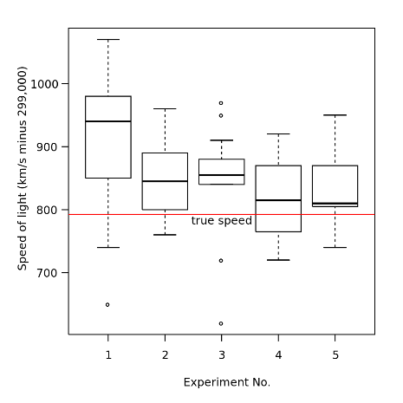
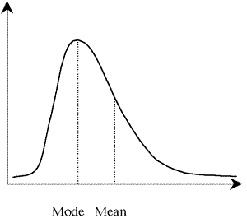
Per attribute
Qualitative
nominal, ordinal
distribution
Quantitative
ratio, interval
discrete/continuous
mean/median
dispersion
Missing values

Slide 25
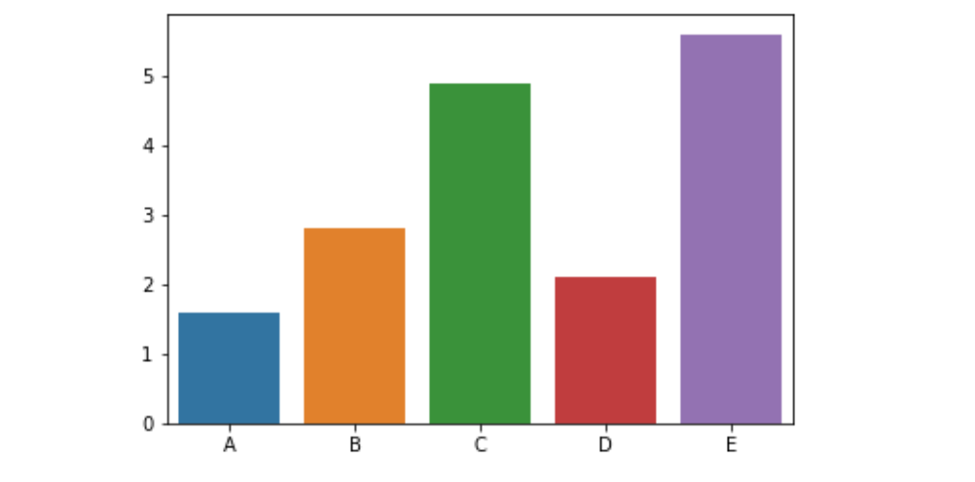
Bar chart
Notes:
JH: A better and BASIC histogram figure --- because this one overlaps with a later one!

Slide 26
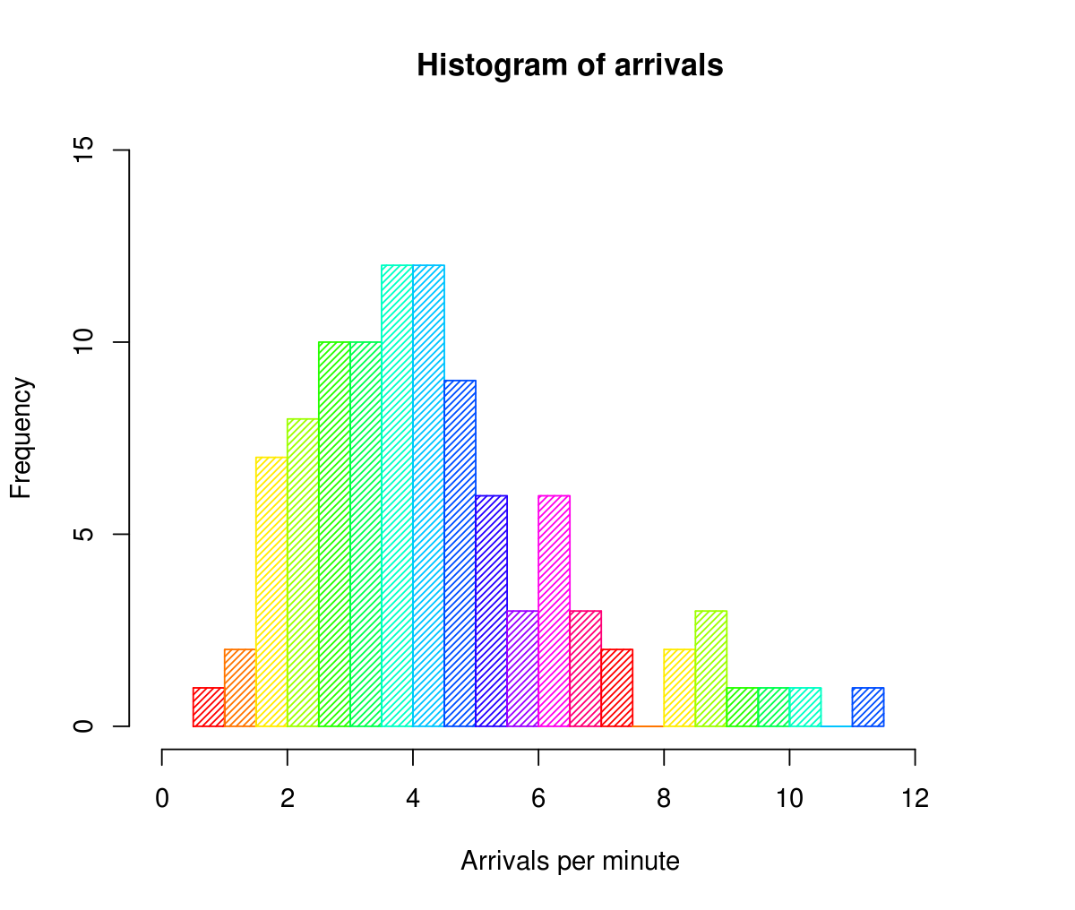
Histogram
Notes:
JH: A better and BASIC histogram figure --- because this one overlaps with a later one!

Slide 27
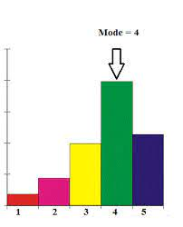
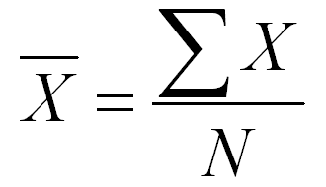
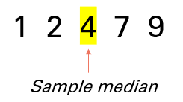
Central tendency
Mode
Mean
Median

Slide 28
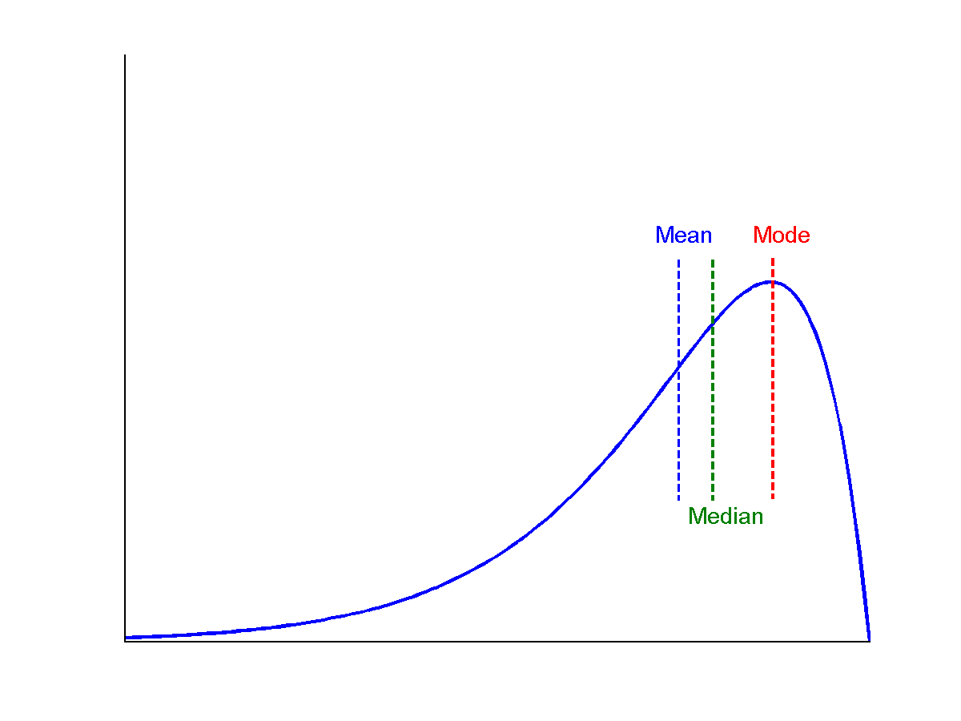
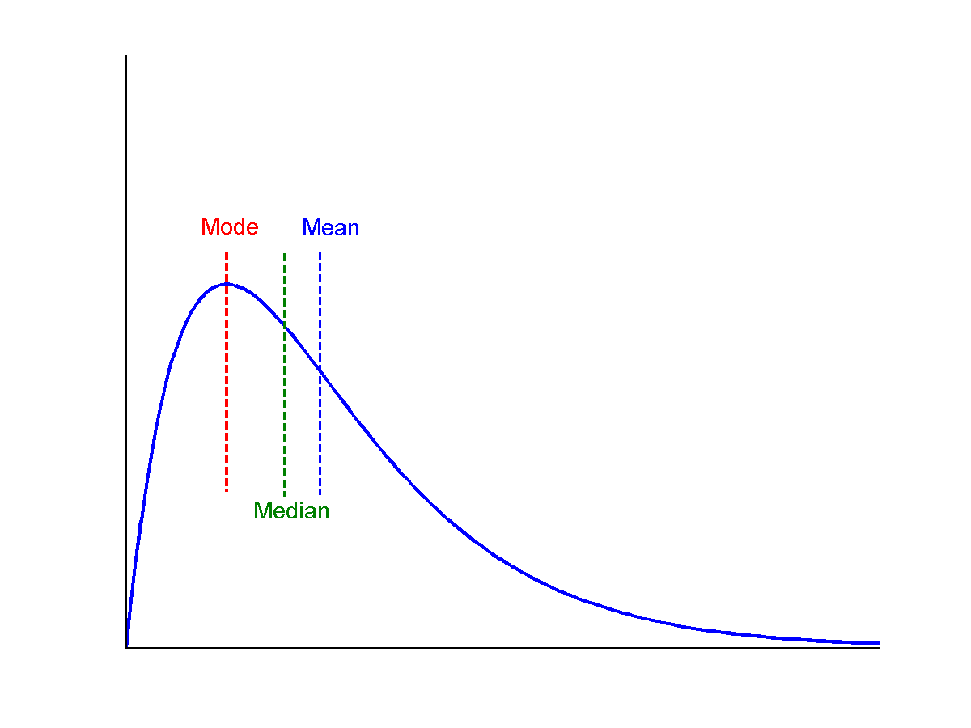
Symmetric vs. skewed
symmetric
positively skewed
negatively skewed

Slide 29
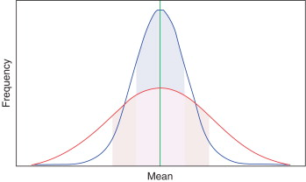
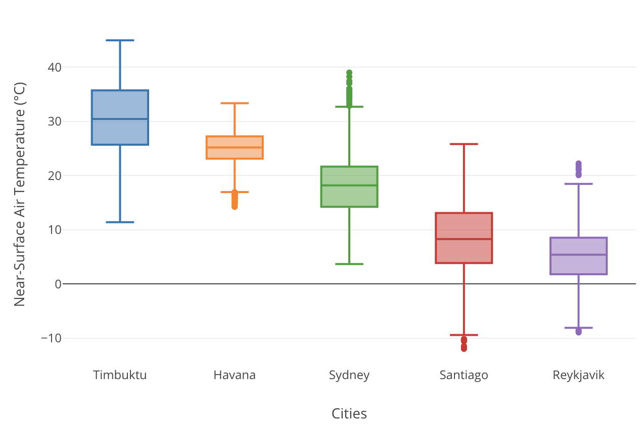
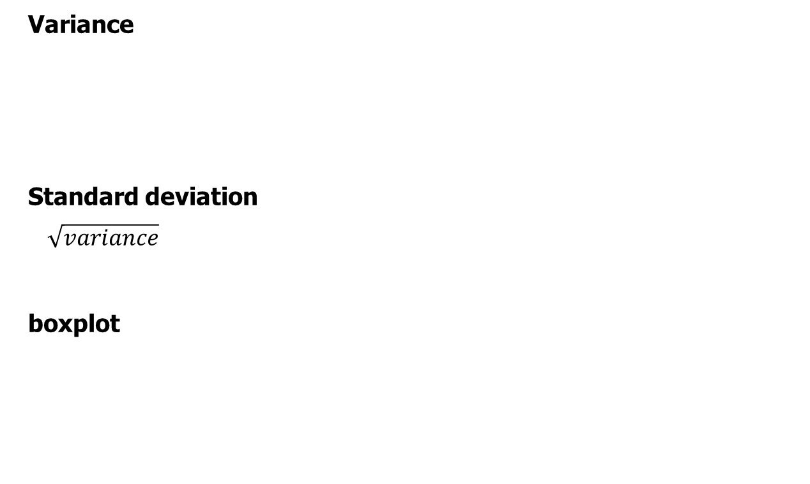
Dispersion of Data
Variance
Standard deviation
$$\sqrt{variance}$$
boxplot

Slide 30
Missing values
Name | Color | Age | Weight
Fikki | Blue | 5
Minoes | UNKNOWN | 7 | 8
Doodles | Red | ? | 34
How are missing values represented?
How many missing values are there
for each attribute?
for each instance?

Slide 31
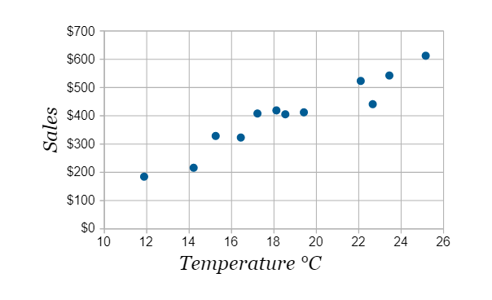
Relation between two variables: scatter plot
Notes:
Need a better and more MEANINGFUL scatter plot! -JH

Slide 32
Correlations

Slide 33
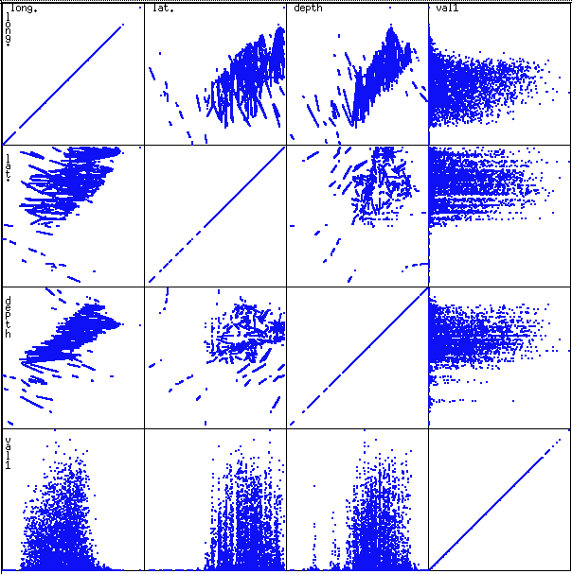
Matrix of scatter plots

Slide 34
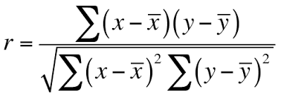
Correlation measures
Numerical data: Pearson’s correlation coefficient
mean x
mean y
x | y
4 | 0.2
6 | 0.8
3 | 0.2
9 | 1.6
10 | 2.7

Slide 35
Correlation measures
Nominal data:
Χ² (chi-square)
Observed | Blue | Green | Yellow
Small | 9 | 45 | 8
Large | 8 | 4 | 26
Observed | Blue | Green | Yellow | Total
Small | 9 | 45 | 8 | 62
Large | 8 | 4 | 26 | 38
Total | 17 | 85 | 34 | 100
Expected | Blue | Green | Yellow
Small | (17/100) * (62/100) | (49/100) * (62/100) | (34/100) * (62/100)
Large | (17/100) * (38/100) | (49/100) * (38/100) | (34/100) * (38/100)

Slide 36

Machine Learning in Python

Slide 37



Data libraries
Numpy
N-dimensional arrays
Array functions
Linear algebra
SciPy
Data processing functions
Pandas
DataFrames
Database-like operations
Data analysis

Slide 38



Machine Learning libraries
Statsmodels
Statistical methods, regression
Scikit-learn
ML algorithms
Tensorflow/keras
Deep Learning algorithms
Year 3:
Minor Deep Learning

Slide 39
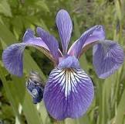
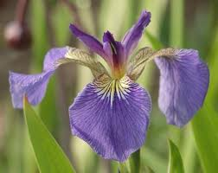
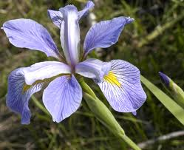
Famous toy example: iris data set
iris versicolor
iris setosa
iris virginica

Slide 40
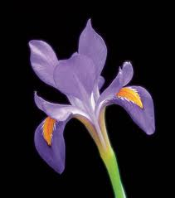
Famous toy example: iris data set
petal
Petal length
Petal width
Sepal length
Sepal width
Class / species:
iris versicolor
iris virginica
iris setosa
sepal

Slide 41
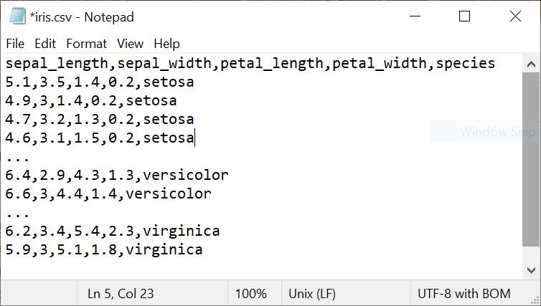
Famous toy example: iris data set

Slide 42
Getting started with sklearn
Demo script Exploration_preprocessing.py

Slide 43
Assignment
Steps
Data exploration
Data preprocessing
Model building (regression/classification)
Model evaluation
Teams of two students
Each team
different data set
corresponding regression/classification task

Slide 44
 | Data set | Predict | Samples | Features
1 | songs on Spotify | popularity | 2,000 | 18
2 | real estate listings | house price | 203,126 | 12
3 | backgrounds of students | dropout | 4,424 | 37
4 | passenger and flight data | satisfaction | 129,879 | 24
5 | credit card transactions | fraud | 1,000,000 | 8
6 | online payments | fraud | 10,485,574 | 10
7 | soccer player data | release clause amount | 18,207 | 89
8 | patient data | thyroid disease type | 9,172 | 31
9 | measurements on marine snails | age | 4,177 | 9
10 | magic cards | rarity | 162,279 | 39
11 | Online news popularity | number of shares | 39,797 | 61

Slide 45
Exercises
3 parts
Build up to assignment
After lectures and 3 dedicated classes
Individually or in teams
Discuss next class
Now start part 1:
Getting started
Data exploration

